Slide 1
SUPERSTORE SALES ANALYSIS
Prepared by: Ifire Kevin Wesonga
Dataset: Superstore Sales Dataset (Kaggle)
Tool Used: Microsoft Power BI

Slide 2
DATASET OVERVIEW
The Superstore Sales dataset contains historical retail sales transactions from a fictional superstore. It includes information about customers, products, orders, sales, profit, shipping, and regional performance.
Key Fields
Order Date
Ship Date
Sales
Profit
Quantity
Discount
Category
Sub-Category
Region
Segment
Customer Name
Dataset Purpose
Analyze sales performance and identify business opportunities through interactive dashboards.

Slide 3
BUSINESS PROBLEM
The management wants to understand:
Which regions generate the highest sales?
Which product categories perform best?
How profitable is the business?
Which customer segments contribute most revenue?
How are sales changing over time?
The dashboard helps decision-makers answer these questions quickly using KPIs and visualizations.

Slide 4
Key Performance Indicators
KPI | Description
Total Sales | Total revenue generated
Total Profit | Overall profit earned
Total Orders | Number of customer orders
Profit Margin | Profit ÷ Sales × 100
Sales Growth % | Growth compared to previous period
Top Region | Region with highest sales
Best Selling Category | Category with highest sales

Slide 5
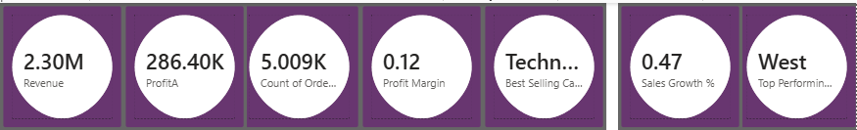
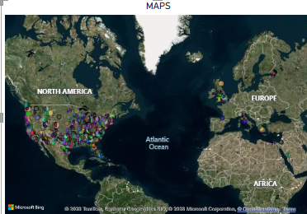
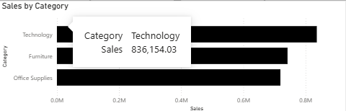

Dashboard Overview
KPI Cards
Sales by Region
Sales by Category
Profit by Segment

Slide 6
Key Insights
Example insights
The West Region generated the highest total sales.
Technology was the best-selling product category.
Sales increased steadily throughout the year.
Corporate customers generated the highest profits.
Some product categories had high sales but low profit due to discounts.

Slide 7
Recommendations
Business Recommendations
Increase inventory for high-performing categories.
Expand marketing in top-performing regions.
Review pricing strategies for low-profit products.
Reduce excessive discounts on unprofitable items.
Focus customer retention efforts on high-value segments.

Slide 8
Challenges Faced
Challenges Encountered
Creating DAX measures for KPIs.
Calculating Sales Growth correctly.
Selecting appropriate visualizations.
Formatting dashboard for readability.
Managing date hierarchy issues in Power BI.
Ensuring dashboard interactivity using slicers.

Slide 9
Conclusion
The Power BI dashboard provides an interactive and comprehensive view of Superstore business performance.
Key benefits include:
Real-time KPI monitoring
Identification of top-performing regions and products
Better understanding of profitability
Improved decision-making through data visualization
This dashboard enables management to make informed, data-driven business decisions.

Slide 10
Thank You

